Slide 1
Profiling Mentally Ill Male Mass Murderers
“Early Origins of Male Violence”
Santa Fe Boys Educational Foundation
Lawrence J. Raifman, J.D., Ph.D.
Santa Fe, NM
May 3, 2019
Notes:
Profiling Mentally Ill Male Mass Murderers presentation will focus on the problem of young male spree killers pose to society. The spree killer, whether or not impacted by mental illness, is a considerable scourge upon society. Factors like easy access to guns, inadequate commitment laws governing dangerous mentally ill persons, the profession’s inability to predict dangerous behavior, and the frenzied response of media, each contribute to the increasing frequency of spree killing incidents.
Relying upon selected case studies, we will explore classification efforts, the role of profiling, the special case of religious and/or political extremists, as well as weapons built for mass destruction, and cultural considerations in an effort to answer the question, “Can the forensic psychologist identify the young male spree killers before they act?”

Slide 2

Evan video – Sandy Hook Promise

Slide 3
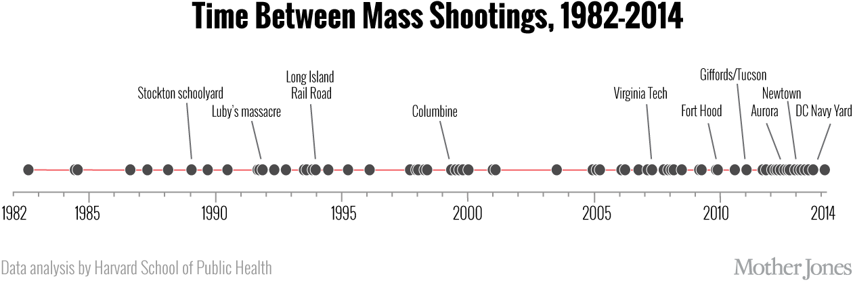
Harvard School of Public Health

Slide 4
Mass Killing myths perpetuated in the media
Typical media responses:
Rampage killings are “senseless,” and “tragic.”
“Wondered if they knew the person at all.”
“He seemed like a good person, he kept to himself.
Usual questions are raised: “What made him snap?”
He must have been mentally ill. He was probably “depressed?”
  First Myth:
  Shooters suffer from a special diagnosable mental disorder (see, Victoroff, 2005; Silke, 2003; Gill and Corner, 2017)
Notes:
Early efforts tended predominantly to focus on the individual, and assumed that mass murder behavior is consistent with a diagnosable mental or personality abnormality. Crenshaw, 1981, prior to 9-11 recognized that pathology is not a good differentiator for predicting mass murder.
Forty years of terrorism research has firmly debunked the notion that mentally illness is the key to understanding mass murderers.

Slide 5
Mass Killing myths perpetuated in the media
Other myths about mass murderers are:
  Shooters have impulsive personalities, they snap!!
  Shooters have experienced personal trauma; they are in crisis.*
  Shooters take revenge against bullies who make them miserable.**
  Shooters are “psychopathic killers.”
  Shooters are unstoppable – these massacres are inexplicable; beyond our comprehension to explain.
*Columbine shooters were A students, worked together at a local pizzeria, Harris was known for his clam disposition and charm, Kelbold was known as his side kick.
**Harris and Klebold were not ostracized by their classmates. They were actively involved in school activities. Their “basement” tapes had hardly any mention about being bullied or picked on.
*** Stoneman Douglas High School in Parkland, Fla suggestion that if the killer’s classmates and peers had been a little nicer to him, the shooting would never have occurred. Wrong: no amount of compassion would have changed the person he was, or the horrendous acts he perpetrated.
Notes:
Actually, shooters are often young males, who believe they are carrying out a mission (a revenge fantasy). Shooters meticulously plan the crime (they don’t snap), they frequently imitate prior rampage killers or model themselves after pseudo war commandos. Also, they are seen by their victims as cold and calculating, though they are not psychopaths.

Slide 6
Specific Myths about Columbine persist
Popular narrative suggests Columbine was a school shooting—it wasn’t.
  They had been falsely regarded as disaffected teenage shooters (e.g. outcasts, loners, targets of bullying, misfits, members of the “Trench Coat Mafia”).
  Harris and Klebold intended to terrorize the entire nation by attacking a symbol of American life, their high school.
  They sought to achieve a death toll* larger than the Oklahoma City bombing incident.
    The timing of Columbine was to be the anniversary of the Oklahoma City mass murder.
    It was to be a bombing in the school cafeteria that would kill 600;
    To be followed by gunning down fleeing survivors, and then
    An explosive third act when their cars, previously packed with more bombs, would rip through more people.
  They wanted infamy; a killing spree that would cause the world to take note of their power.
    (This is similar to the aspirations of the Sri Lanka Easter killers, the New Zealand Mosque attacker.)
The point: Media has a misguided focus on the spree killers’ content, their self serving presentation, rather than a focus on their pathway to violence.
  *The goal was to kill more – “the most deaths in US history.” (Klebold boasted on video.)
Notes:
Columbine set the script for mass murder incident coverage:
1. Begin with live reports from the scene, repeatedly air images of people fleeing
2. Bring on experts to offer their assessments, focus on the perpetrator, his motives…their upbringing…
3. Cover law enforcement press conferences
4. Identify victims, force the victims to grieve in a fishbowl, and talk about societal changes needed.
Why did it begin with Columbine?
Due to the advent of 24 hour a day cable news coverage, which promoted fame seeking violent actors.
Reliance on CCTV footage of the shooting
The discovery that exploitation of our fears produces a public fascination, people will watch

Slide 7
The social media problem.
The problem is the social media has contributed to a copycat effect. Three examples:
  August 2015: In Virginia, an ex television reporter, Vester Flanagan, carried out what was dubbed, “the first social media murder.” Vester Lee Flanagan, a disgruntled employee, shot to death Allison Parker and her camera man, Adam Ward, two of his former colleagues, while wearing a Go-Pro camera. He uploaded the video before killing himself.
  June 2016: Two days after Orlando, a 25 year old man in France stabbed an off duty police officer and his female companion to death, and filmed himself live on Facebook while inside the couple’s home. After he pledged allegiance to ISIS he contemplated the killing of the couple’s three year old son.
  April 2019: The New Zealand shooter attacked mosques in Christ Church while live streaming his assault, which went out live to the Internet.
    The New Zealand spree killer referenced Vester Flanagan in his manifesto.
This imitation trend makes difficult our ability to determine a motive: is it a hate crime, a terror attack, or a disturbed person’s actions, or all of the above?
Notes:
August 2016: Presentation at the APA by Jennifer Johnson, Ph.D., concluded: “media contagion” is largely responsible for the increase in these often deadly outbursts. See, Media Contagion is a factor in mass shootings, Security Newswire, August 10, 2016
Reid Meloy (forensic psychologist and threat assessment expert), “ …we’re going to see more of this movement toward real time broadcasting of these events…fulfilling their desire to be seen and to gain notoriety.”
Vester Flanagan said in a fax delivered to ABC News that he took his inspiration from the Columbine, Virginia Tech killers, and the Charleston church massacre (that had occurred months before). .

Slide 8
Specific guidelines for reporting on mass killings
The four guidelines for reporting on mass killings*:
  1. Do not name the perpetrator.
  2. Do not use photos or likenesses of the perpetrator: no notoriety
  3. Stop using the names, photos or likenesses of past perpetrators.
  4. Report everything else about these crimes in as much detail as desired.
Alternative rules**:
  Never publish shooter’s propaganda or motives.
  Don’t report biography of shooter or dwell on shooter’s motive.
  Minimize the gory details – don’t make the body count the lead story.
  No photos of the event – no photos of the killer.
  Talk about victims but minimize images of grieving families.
*Lankford A., Madfis E. Don’t name them, don’t show them, but report everything else: A pragmatic proposal for denying mass killers the attention they seek and deterring future offenders. American Behavioral Science. 2017. Professors Adam Lankford and Eric Madis noted, “by no longer publishing the names or images of mass killers, the media would stop giving them the attention they often seek, and likely deter some future perpetrators from attacking.”
  **Ari Schulman, What mass murderers want---how to stop them. Wall Street Journal, 11-8-13,

Slide 9
Good Application of the rules
  Prime Minister of New Zealand, Jacinda Ardern, noted of the perpetrator:
  “He sought many things from his act of terror, but one was notoriety.
  That is why you will never hear me mention his name.”
Notes:
Facebook admitted the mosque shooting videos were shared 4,000 times before they were noticed and taken down.
The social media giant also said that it removed some 300,000 copies of the video in the first 24 hours and blocked 1.2 million copies from being uploaded.

Slide 10
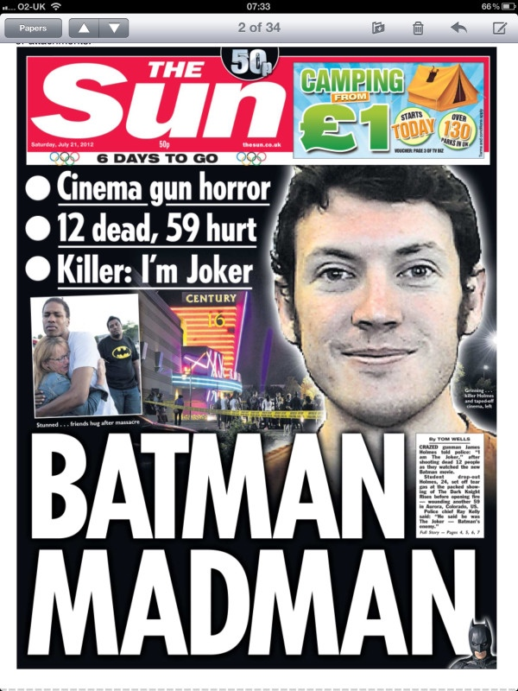
Bad application of the rules: “The Sun” fails the test

Slide 11
Finally, a new disturbing social media challenge
Social media have enabled the harassment of survivors and victims’ families…
  Alex Jones, who is being sued by multiple parents of children killed in Sandy Hook Elementary School shooting for emotional distress, had claimed the parents of dead children were lying.
    In his defense, he has tried to blame psychosis (i.e. delusional thinking) bought on by the pressures of his job.*
    Meanwhile, the victim of the shooting, Alison’s father has been in a four year fight with Google to remove the video.
      He faces on-line trolls who accuse him of faking his daughter’s death: one troll claims she had plastic surgery and is now living in Israel.
      Alison Parker’s father noted, “Whenever these guys get attention, it just creates copycats and others come out to attempt the same thing.”
    *In the deposition, he stated, “…I myself have almost had like a form of psychosis back in the past where I basically thought everything was staged, even though I’m now learning a lot times things aren’t staged…”

Slide 12
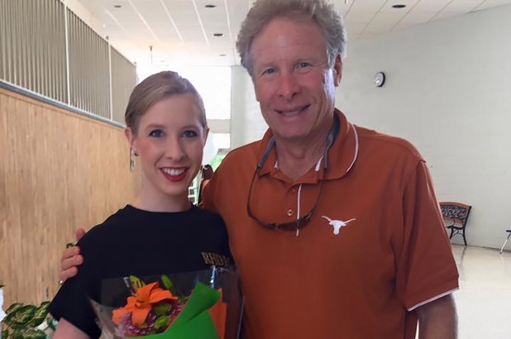
Alison Parker and her father

Slide 13
Profiling v. Pathway to violence
Profiling mass murderers
  Identify attributes or traits to look for
  Static
  Controversial –
    Targets persons for special attention
    Questions of validity, reliability
Pathway to mass murder
  Embraces a highly complex, developmental focus:
    (Think of the pathway as a series of sequential profiles).
  Serves as metaphor to get us thinking about why a subgroup on the pathway exit via an “off ramp” before acting.
  Helps to gauge the speed by which the individual moves along the pathway:
    (Internet silo-ing speeds movement down the pathway)
  Helps to target effective intervention strategies
  Focuses efforts to interrupt would be spree killers in the late stages on the pathway
  Encourages a data centric focus

Slide 14
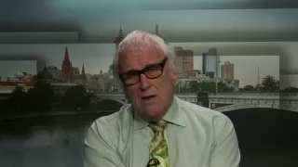
Dr. Paul Mullen Australian psychologist, evaluated Martin Bryant, the “Port Arthur massacre” killer offers his profile
Notes:
Dr. Paul Mullen examined the psychological profiles of five perpetrators of mass killings who were captured alive.
He found:
These individual were often bullied in childhood.
They had personalities marked by suspiciousness.
They showed obsessional traits, grandiosity and persecutory beliefs.
They intended to kill as many people as they could and then kill themselves.
They were influenced by heavily publicized cases of other mass shootings.
Mullen, P.E. The autogenic (self generated) massacre. Behavioral Science and the Law, 2004; 22:311-323.

Slide 15
Relevant profiler factors
Meloy, Hempel, et al. studied adolescent mass murderers and found the following characteristics:
    Male,
    Described as "loners" by others,
    Abused alcohol or drugs,
    Bullied by others in the past,
    Depressive symptoms and prior history of antisocial behaviors,
    Recently suffered a perceived failure in love or school (Turvey 2008)
    Meloy, Hempel, Mohandie,Shiva, Gray, “Offender and offense characteristics of non random sample of adolescent mass murderers,” J. Acad. Child Adolescent Psychiatry, 40, June 2001.
Hempel et al. found the following characteristics of mass murderers.
    Male single or divorced 40-50 years of age
    Have paranoid and/or depressive conditions
    Recently suffered a major loss related to employment or relationship,
    Alcohol plays a very minor role,
    Death occurs by suicide or at the hands of others (police)
    Hempel, A. Meloy, R. and Richards, T., 1999, “Offender and offense characteristics of non random sample of mass murderers,” Journal of American Academy of Psychiatry and Law, 27(2), 213-35.

Slide 16
Progression to becoming a Serial sexual sadist (incremental changes)
  Park Dietz identified a gradual progression --
    Sexual sadists discover sadism in themselves between ages 8 and 14.
    Initial response is to suppress the impulses, put it out of mind.
    Confine the thoughts to fantasy during masturbation or sex with partner
    Use sexually sadistic porno for arousal, which is readily available.
    Enable mild socially acceptable sadistic activities with a consenting partner who may or may not enjoy it. Find the right ad or meet them at a BDSM club
    Pay a prostitute to pay for submissive sex or S&M
    Pressure a sexual partner to submit under threat of abandonment or replacement. Unduly influence by making her dependent, isolated, etc. Destroying self esteem, making her dependent using skills of undermining.
    Exploit vulnerable people, poor, young, intoxicated, addicted, developmentally disabled, unstable, or otherwise impaired, etc --- to a totally abused sex slave to a sadist
    Commit sexually sadistic assaults through force or threat of force. Kidnap, captive and abuse and kill.
Notes:
Psychopathic & sexual sadists:
In 1982 Dietz study of pornographic imagery and prevalence of paraphilia in Bergin County, NJ.
.
Sexual Sadists that commit violent sex crimes often have dual mental disorder diagnoses.
That is, apart from their sexual desires, they are often psychopaths, and suffer from personality disorders, substance abuse.
Far less often they are psychotic or have a organic brain disease.

