Slide 1
2. Serial, Spree, and Terrorist Mass Murderers

Slide 2
Definitions: Spree vs. Serial killers
Spree killers are distinct from serial killers:
Single act, or short period of time
  No cooling off period
  Expect to get caught, commit suicide, suicide by cop
  Killing occurs in public places
  Killing by automatic weapons, explosives, now low tech weapons
Similarities for spree and serial killers
  Kill multiple people
  Planning and Preparation
  Reliance on over riding power/force
  Often no relationship to victim

Slide 3
Spree killer motivation, victim selection, relationship to victim, mobility of killing
Spree Killers
  Instrumental killings ---victim deaths regarded as a means to achieving a purpose; victims are chosen to become a symbol, “a representative victim.” Victims are often there by chance, (in the wrong place, wrong time), or have only a peripheral affiliation to the perpetrator
  Columbine victims, e.g., Students and faculty, were not motivated by resentment of them in particular. Students and teachers were a convenient quarry, e.g. collateral damage.
Serial killers
  Lust killings (sexual deviant)
  Victim-specific targeted killer (prostitute, homeless)
  Professional killer
  Signature

Slide 4
Serial killer typologies
“Visionary” type: psychotic, hears voices and sees visions, driven to kill by these delusions or hallucinations. David Berkowitz, the son of Sam attempted to suggested that he was persecuted by delusional, killed 17, when in fact he was malingering.
Mission oriented not psychotic, wants to rid the world of immoral or unworthy targets, usually homosexuals, women, or religious groups; either God mandated serial killers, or demon mandated serial killer.
Hedonistic type (lust, thrill) serial killer motivated by sexual,
  Erotic pleasure killers, e.g. Jeffrey Dahmer, Jerry Brudos, Douglas Clark.
  The thrill killer kills for the pleasure in killing, Ted Bundy example.
  The comfort killer gets material gain, the good life
The power seeker controls the victims, e.g. Ed Kemper, taking possession of everything that used to be the victim’s control
Organized killers, psychopaths, use restraints to control victims, sex aggression, follow crimes in the news, use charm, manipulation, intimidation, violence,
Disorganized killers: not intelligent, not socially skilled, anxious during crime, motivated by sex, leave evidence at crime scene.

Slide 5
“A mother’s reckoning,”
Sue Klebold – The Autogenic Hypothesis
Sue Klebold: Living in the aftermath of tragedy.
  Dylan Klebold’s mother lives with the perception from others that she failed her son, and contributed to the destruction of life he caused.
How did his suicidal thinking become homicidal?* Murder suicide
Her answer: He had depression; he had a perfectionistic personality, and he experienced triggering events at school that left him feeling debased, he also had a complicated relationship with Harris.
*“Autogenic hypothesis”: Is mass murder “foreplay to suicide by cop?” ( Paul Mullen, 2004)
Notes:
She noted, “Dylan did not want to kill, he wanted to die.”
Adding, 1% to 2% of all suicides are accompanied by murder. “We do not make the choice to die by suicide. It is a symptom of pathology.”
She wrote: “I would have to turn what I thought I knew about myself, my son, and my family inside out and around, watching as a boy became a monster, and then a (suicidal) boy again.”

Slide 6
Dr. Raifman’s spree killer classification
  Pseudo commando ---rampage killing event, well planned, targeted, there is the inevitability of getting caught, likelihood of suicide
    Targeted group killer with vendetta (Elliott Rodger, Andres Breivik)
    School killer (Harris & Klebold at Columbine)
    Mentally Ill who are idiosyncratically inspired: Unclear/Incomprehensible motivation (James Holmes, Jared Loughner)
    Psychotic + (something more) Spree Killer -likely insane at the time of the killing, more rare, crime behavior can result in multiple deaths, e.g., family, children, colleagues, (Charles Whitman, DC Naval Yard shooter)
  Disgruntled or fired employee
  Murder/Suicide & Family annihilator killing spouses/intimates/children prior suicide (Andrea Yates)
  Sexual homicidal killer (Richard Speck, Dunblane massacre)
  Religious/Disciple murderer (New Zealand, Sri Lanka, Jim Jones, Charles Manson, Nadal Hassan-Ft. Hood)
  Set and run killer exception (Oklahoma City bombers, Dylan Roof, San Bernardino shooters);--human suffering to gain attention for political/religious purpose (Charlie Hebdo Paris)

Slide 7

Psychotic Killer: Charles Whitman

Slide 8
The implications of the Whitman “Texas Tower” case
http://www.towerdocumentary.com/
In the wake of the Texas Tower case the following precedent setting actions occurred:
  The public turned to psychiatrists and psychologists to explain terrorist behavior; to answer the question, “Who becomes a terrorist?”
  Experts relied on autopsy reports to find mental illness and neurological impairments
  Experts risk false validity statements by referring to personality traits, which according to Monahan 2015 article, page 14, he concluded, that personality traits have not been found “to distinguish those who engage in terrorism from those who refrain from it.”
  Experts risk false validity by referring to static qualities or conditions to aid in the prediction how a diverse gorup become involved in terror behavior.

Slide 9
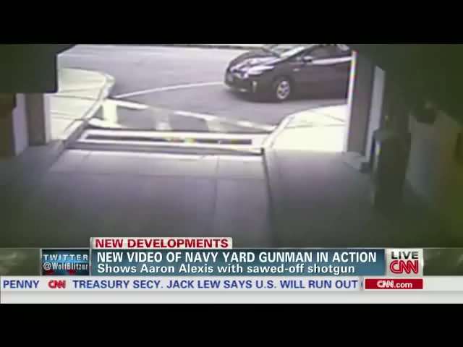
Psychotic Killer: Aaron Alexis (Washington Navy Yard)

Slide 10
Definitions: Spree killer v. Terrorist
The FBI defines mass murder as “Four or more murders occurring during the same incident, with no distinctive time period between the murders. These events typically involve a single location, where the killer murdered a number of victims in an ongoing incident." The Colorado shooting by James Holmes was a classic example of a spree mass murder.
The FBI defines terrorism as “the unlawful use of force or violence against persons or property to intimidate or coerce a government, the civilian population, or any segment thereof, in furtherance of political or social objectives.”
Similarity between terrorist and spree killer: All mass shootings are “theatre” (public spectacle) in that their purpose is to create terror. The combination of a public spectacle resulting in random death followed by suicide is an attack on society, suicide gives the perpetrator a final control---denying justice. (Mark Manson calls them non-political terrorists.)
Difference between terrorist and spree killer: "The active shooter, tends more often than not to be motivated by a deeply personal grievance tinged with feelings of persecution and humiliation, real and perceived, whereas terrorists are oftentimes going to be motivated by more ideological reasons." (Andre Simons, leader of the Behavioral Analysis Unit at Quantico, Tom Junod, “A radical new look at mass shootings.” Esquire Magazine, October 24, 2014.)

Slide 11
Differentiating factors:
Terrorists v Spree Killers
Terrorists Differentiating Factors:
  Non idiosyncratic purpose
  Non psychotic diagnosis
  Ideological or religiously inspired
  Employs “set and run exception”
Terrorist Examples:
  Charlie Hebdo
  San Bernardino shooters
  Oklahoma City bomber
  Boston Marathon Bombers
  Ft. Hood Shooter – Nadal Hassan

