Slide 1
Neuro-cognitive systems underpinning antisocial behavior: Implications for male violence
R.J.R. Blair
Center for Neurobehavioral Research
Notes:
Welcome to the rollout of our New Strategic Plan for 2018-2022

Slide 2
Talk Plan
1. Determine the neuro-cognitive systems that, when dysfunctional, increase aggression risk?
2. Outline what is know about environmental influences (maltreatment) on the development of these neurons-cognitive systems
3. Discuss why males might be at increased risk for at least some of these forms of dysfunction.
4. Determine the impact of testosterone and why this hormone has an impact on aggression risk.

Slide 3
What are the neuro-cognitive systems that, when dysfunctional, increase aggression risk.
“Empathy”
Acute Threat response
Response control
Reinforcement-based decision-making

Slide 4
What are the neuro-cognitive systems that, when dysfunctional, increase aggression risk.
“Empathy”
Acute Threat response
Response control
Reinforcement-based decision-making

Slide 5
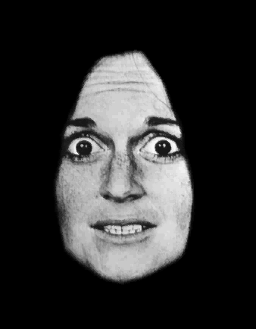
“Empathy”
The fearful expression: A signal of distress.
A healthy response to this distress cue involves an interruption in current behavior and learning the negative value of actions associated with this distress.

Slide 6
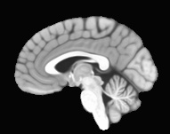
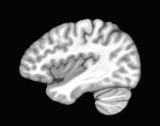
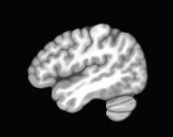
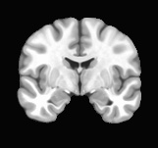
“Empathy”
3: Emotional processing
Amygdala -> mPFC (and anterior insula cortex)
1: Perceiving:
Visual cortex -> Temporal cortex -> Amygdala
4: Attending
Amygdala -> PCC -> Parietal cortex -> lateral frontal cortices
2: Interrupting
Amygdala -> Hypothalamus -> PAG

Slide 7
Callous Unemotional Traits
DSM-5 (low prosocial emotions)
Lack of remorse or guilt
Callous-lack of empathy
Shallow or deficient affect
Unconcerned about performance
Notes:
My training has primarily focused on these youth with CU traits so here is a very brief overview of CU traits:
-In 2013 -CU traits were integrated into DSM-5 as a specifier for conduct disorder
So if a kiddo has conduct problems for a year and also exhibits at least two of these symptoms – lack of remorse, callous lack of empathy, unconcerned about performance, or shallow or deficient affect – they meet criteria for this specifier
These kiddos are important because they often engage in antisocial behavior and come into contact with the juvenile justice system → my graduate work focused on these youth in the juvenile justice system with the crossroads study, which is a comprehensive examination of how different forms of processing affect youth over time
I’ve continued to study CU traits but have shifted my focus to understanding the neurobiology of CU traits with functional MRI – which lead me to work w/ Dr. Blair and Dr. White at Boys Town after they left NIMH
So today I’ll be sharing some exciting work that we’ve been able to do focusing on fMRI data on youth with CU traits and the importance of the amygdala

Slide 8
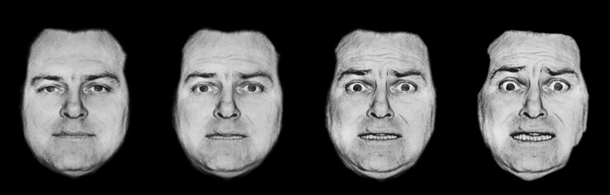
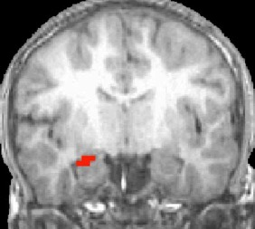
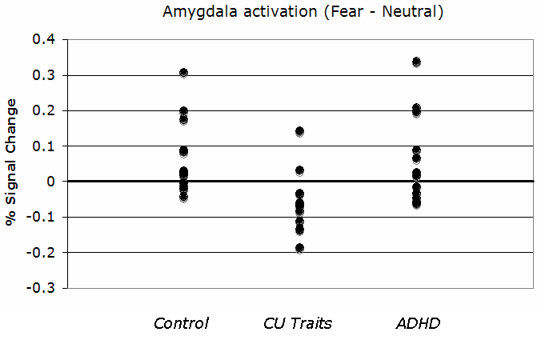
Empathy: The response to the distress of others. It is significantly reduced in those with conduct disorder and callous-unemotional traits (Marsh et al 2008).

Slide 9
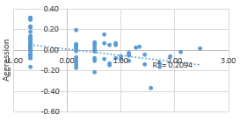
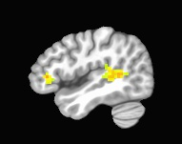
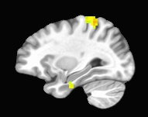
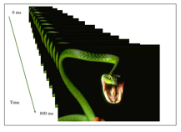
Aggressive Incidents
(Tyler et al., in preparation)
Right Inferior Frontal Gyrus
Aggressive incidents in the first 90 days of the program were associated with decreased response to threatening stimuli (N=90).
Right Middle Temporal Gyrus
Right Inferior Parietal Lobule

Slide 10
The neuro-cognitive systems that, when dysfunctional, increase aggression risk.
“Empathy”
Acute Threat response
Response control
Reinforcement-based decision-making

Slide 11
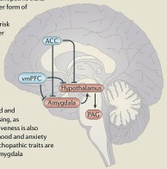
Acute Threat Response
(Blair, Nature Neuroscience Reviews, 2014; cf. 2004)

Slide 12
Affective Stroop Task (Blair et al., 2007)

Slide 13
Hwang et al (2015)

Slide 14
The neuro-cognitive systems that, when dysfunctional, increase aggression risk.
“Empathy”
Acute Threat response
Response control
Reinforcement-based decision-making

Slide 15
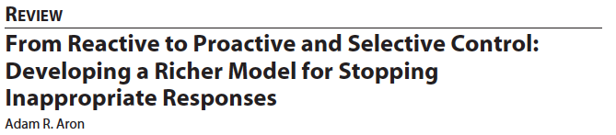
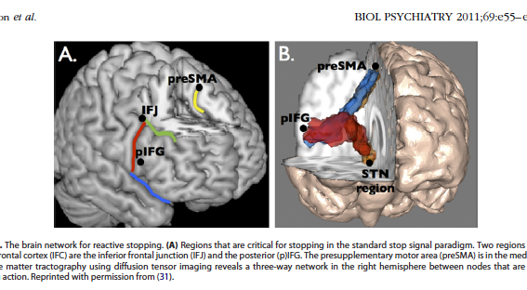

Slide 16
Affective Stroop Task (Blair et al., 2007)

Slide 17
Decrease activation in insula in children/adolescents with DBD (N=35, HC=18) in presence of increased cognitive demand and its correlation with ADHD symptom severity (Hwang et al., 2015)
(Hwang et al, 2016)

Slide 18
The neuro-cognitive systems that, when dysfunctional, increase aggression risk.
“Empathy”
Acute Threat response
Response control
Reinforcement-based decision-making

Slide 19
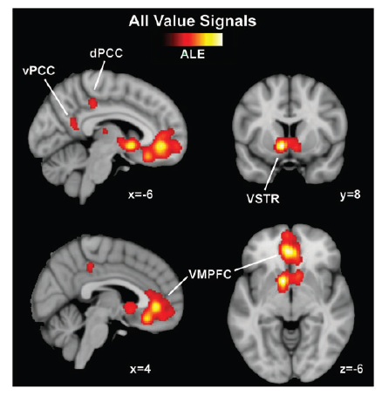
Reward Response (Clithero & Rangel, 2014)
Possibility: Excessive ventral striatal responses to the reward value of objects in the immediate environment could increase impulsive behavior (Casey & Jones, 2010), including substance use (cf. Edalati et al., 2018; Heitzeg et al., 2015) and CD/CP.
Possibility 2: Reduced reward sensitivity/ responsiveness, particularly within regions such as vmPFC, critical for the representation of long-term goals, should result in an individual who makes poorer decisions/be impulsive (Blair et al, 2018). They should be poorer in representing the long-term implications of their actions.
In addition, they are more likely to become frustrated; their actions will be less likely to achieve their goals (Blair, 2010). Increased frustration is associated with increased reactive aggression (Berkowitz, 1993).

Slide 20

Passive avoidance learning (White et al, AJP)
“Early” study: Finger et al. AJP, 2011. Apparent signaling to early reinforcements within OFC and caudate .
Critical though to distinguish BOLD responses to cue from those to feedback.
Lose $5
(OR
-$1/+1$/+$5)
1000ms
0 - 3000ms
1000ms
0 - 3000ms
Regressors for Chosen, Non-Chosen and Reward, Punishment were weighted according to learning theory: Rescorla-Wagner:
Prediction error for the current trial_{(t)} equaled the feedback value for the current trial minus the expected value for the current trial.
PE_{(t)} = F_{(t)} - EV_{(t)}
EV was calculated via the following formula:
EV_{(t)}= EV_{(t-1)} + (α*PE_{(t-1)})

Slide 21
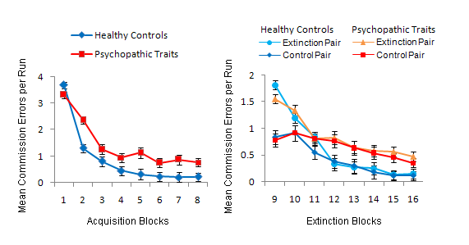
PA details; Impairment in CD
Impairment in learning to avoid “bad” responses.

Slide 22
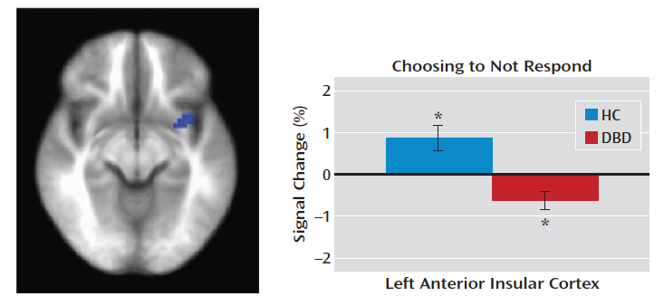
White et al (2013: N=36):
Avoidance responding

Slide 23
Summary 1: The neuro-cognitive systems that, when dysfunctional, increase aggression risk.
CU traits, instrumental aggression
Irritability? Reactive aggression
Impulsiveness (may exacerbate other issues)
Increased aggression
“Empathy”
Acute Threat response
Response control
Reinforcement-based decision-making

Slide 24
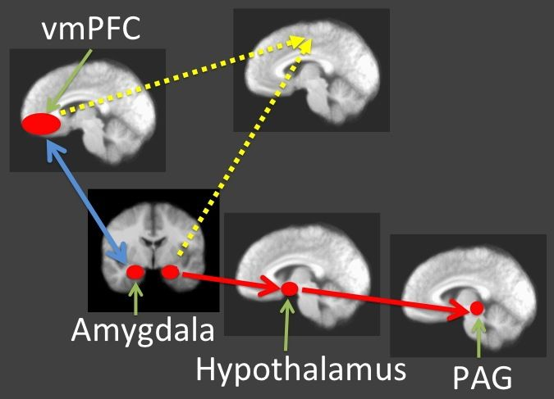
“Instrumental-reactive” Aggression

Slide 25
A
Pam takes $10 and offers you $10.
Pam takes $10.
You get $10.
E
B
Pam takes $14 and offers you $6.
Pam gets $13.
You get $2.
F
Press:
1 to ACCEPT.
2 to spend $1 and make Pam lose $7
3 to spend $2 and make Pam lose $14
4 to spend $3 and make Pam lose $21
Pam takes $16 and offers you $4.
Pam gets $6.
You get $1.
G
C
D
Pam gets -$1.
You get $0.
H
Pam takes $18 and offers you $2.
Offer-phase
3 seconds
Jittered Interval
.5-3.5 seconds
Decision-phase
4 seconds
Outcome-phase
3 seconds
Jittered Interval
.5-3.5 seconds

Slide 26
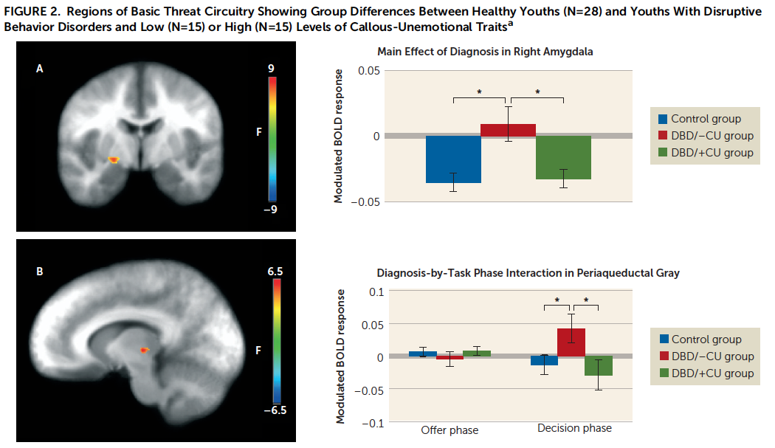
White et al (2016)

Slide 27
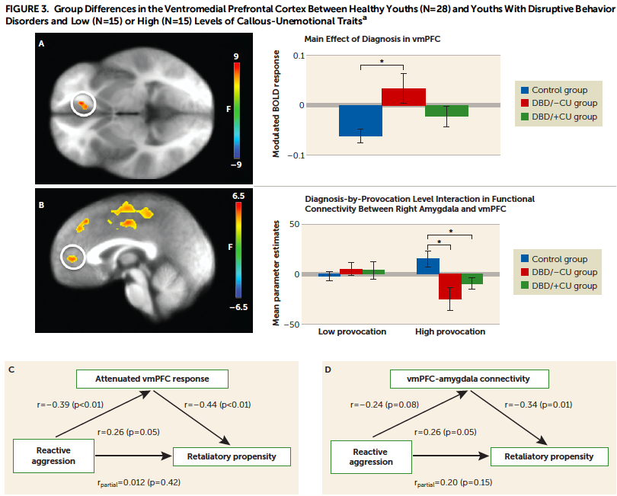

Slide 28
2. Outline what is know about environmental influences (maltreatment) on the development of these neurons-cognitive systems
“Empathy”
Acute Threat response
Response control
Reinforcement-based decision-making

Slide 29
Looming task
(Coker-Appiah et al., 2013)

Slide 30
Sexual Abuse – Threat Response
Blair, K. S. et al. (in preparation)
Sexual abuse is associated with heightened responses within rmFC and PCC to approaching threats
These are regions involved in representing subjective value and emotional maintenance.

Slide 31
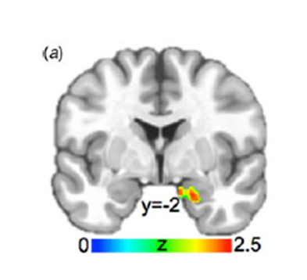
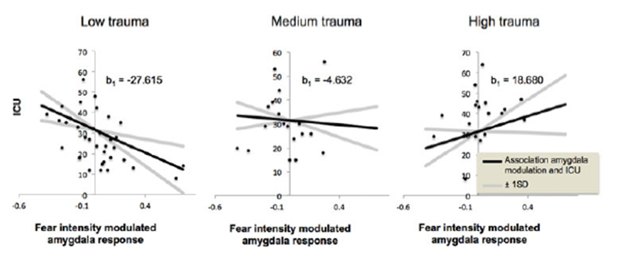
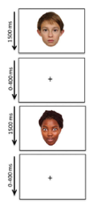
Maltreatment & Callous Unemotional Traits
(Meffert et al., 2018)
Right Amygdala
Low Trauma exposure: As callous unemotional (CU) traits increased, empathic amygdala response decreased.
High Trauma exposure: As CU traits increased, empathic (or at least emotional) response increased.

Slide 32
Maltreatment and Response Control (Blair et al., in press)
We used the Affective Stroop task (Blair et al., 2007) with 116 adolescents.
The majority had experienced some maltreatment (N=101) with some experiencing significant maltreatment (N=55).
Maltreatment was indexed by the CTQ.
Sample selected so that there was no relationship between CTQ scores and IQ/age. However, a sex difference remained.
Data analyzed by 2 (Sex) x 3 (Emotion) x 3 (Task) ANCOVA (covariates being maltreatment dependent measures)

Slide 33
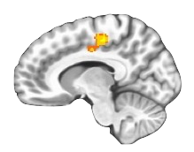
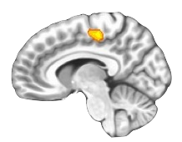
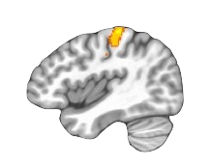
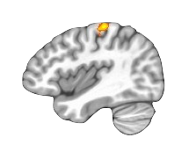
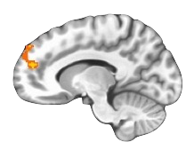
(A)
(A)
c
a
BOLD response
Incongruent>View
BOLD response
Incongruent>View
Abuse Total Score
d
CTQ Total Score
BOLD response
Incongruent>View
b
Abuse Total Score
BOLD response
Incongruent>View
e
BOLD response
View>Incongruent
CTQ Total Score
Abuse Total Score

Slide 34
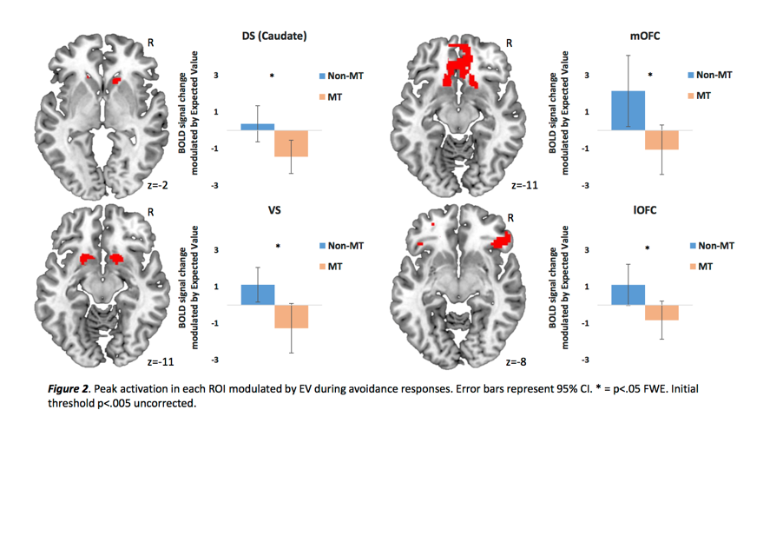
Gerin et al (2017)
Well characterized sample of youth with maltreatment and comparison individuals.
Profound impairment in PE signaling within striatum and vmPFC.

Slide 35
Summary 2: The impact of maltreatment on these neuro-cognitive systems.
CU traits, instrumental aggression
Irritability? Reactive aggression
Impulsiveness (may exacerbate other issues)
Increased aggression
“Empathy”
Acute Threat response
Response control
Reinforcement-based decision-making

Slide 36
3. Are males at increased risk for at least some of these forms of dysfunction?
“Empathy”
Acute Threat response
Response control
Reinforcement-based decision-making

Slide 37
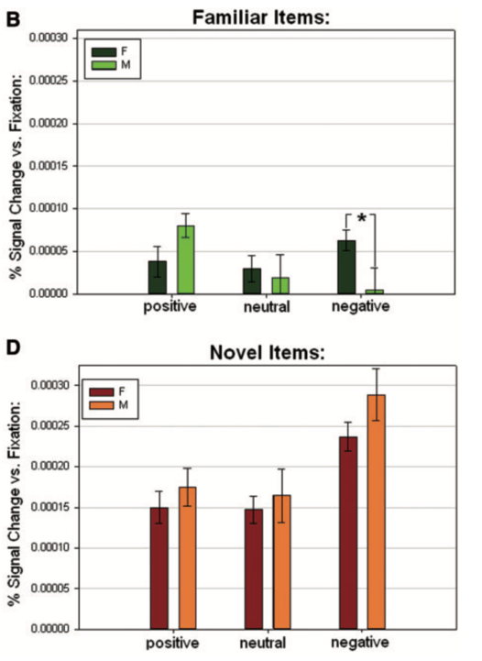
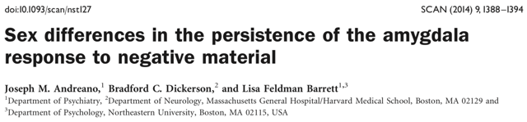
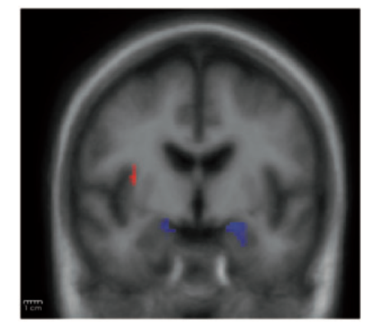

Slide 38
“Instrumental-reactive” Aggression

Slide 39
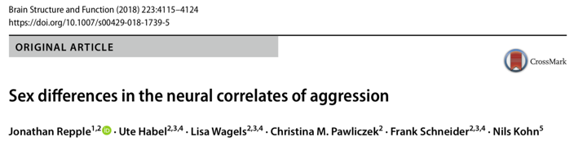
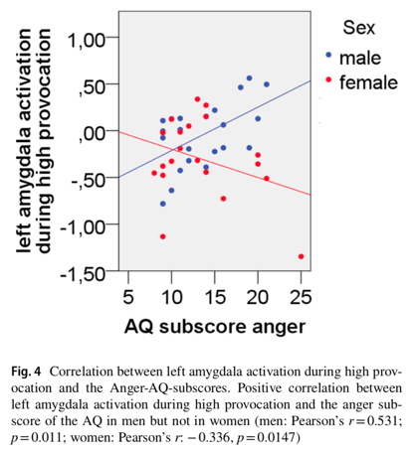
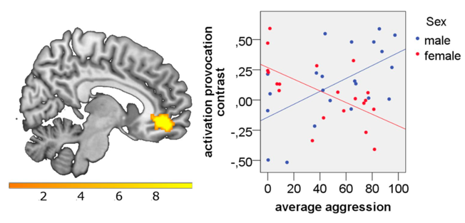

Slide 40
Summary 3: The relationship of being male on these neuro-cognitive systems.
CU traits, instrumental aggression
Irritability? Reactive aggression
Impulsiveness (may exacerbate other issues)
Increased aggression
“Empathy”
Acute Threat response
Response control
Reinforcement-based decision-making

Slide 41
4. Determine the impact of testosterone and why this hormone has an impact on aggression risk.

Slide 42
Basic data
Castration and other forms of testosterone reduction do decrease aggression.
Increases in testosterone do increase aggression. However, only to the extent to which the individual was aggressive pre-procedure – unless the dose is very high.

Slide 43
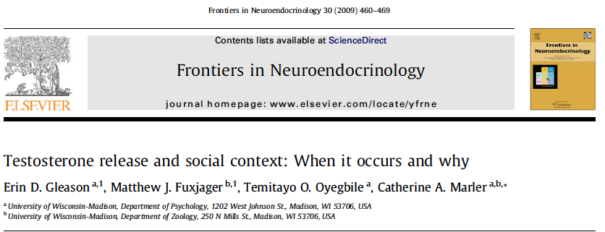
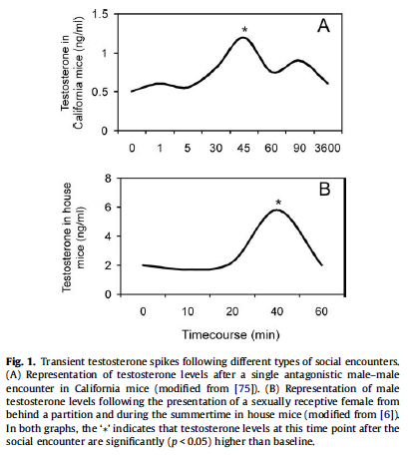
Testosterone release can occur in a variety of social contexts and facilitates various species typical interaction patterns – including aggression

Slide 44
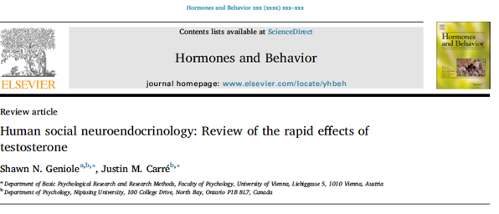
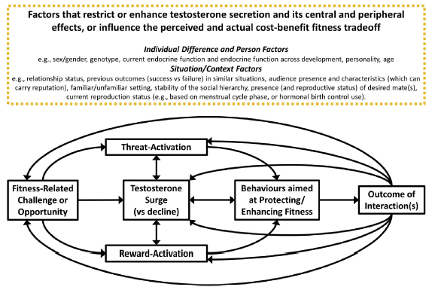
Behaviors aims at Protecting/Enhancing Fitness:
BUT the behaviors available to be chosen are a result of the individual’s learning history ….

Slide 45
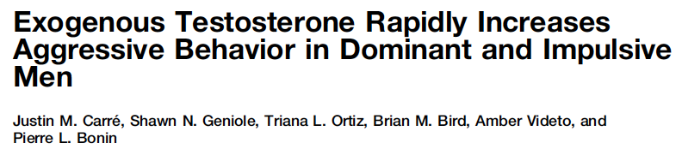
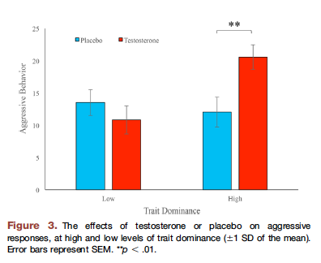
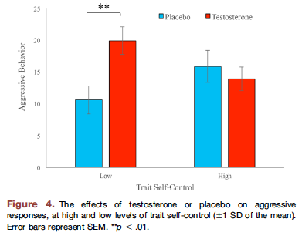

Slide 46
Summary 1: The neuro-cognitive systems that, when dysfunctional, increase aggression risk.
CU traits, instrumental aggression
Irritability? Reactive aggression
Impulsiveness (may exacerbate other issues)
Increased aggression
“Empathy”
Acute Threat response
Response control
Reinforcement-based decision-making

Slide 47
Summary 2: The impact of maltreatment on these neuro-cognitive systems.
CU traits, instrumental aggression
Irritability? Reactive aggression
Impulsiveness (may exacerbate other issues)
Increased aggression
“Empathy”
Acute Threat response
Response control
Reinforcement-based decision-making

Slide 48
Summary 3: The relationship of being male on these neuro-cognitive systems.
CU traits, instrumental aggression
Irritability? Reactive aggression
Impulsiveness (may exacerbate other issues)
Increased aggression
“Empathy”
Acute Threat response
Response control
Reinforcement-based decision-making

Slide 49
Summary 4: So why are males significantly more aggressive?
Testosterone
But not via a direct effect
Rather via its role in protecting/enhancing fitness
The forms of dysfunction associated with aggression may not be more common in males relative to females (though they may be).
However, testosterone facilitates the expression (aggression) of those forms of dysfunction.
Increase acute threat response/Dysfunctional vmPFC modulation
Retaliatory aggression
Provocation
Testoterone
More socially acceptable response

