Slide 1


Improving the Life Chances of Disadvantaged Mothers and Children with Home-Visiting by Nurses:
Differences for Males and Females
David Olds, Ph.D
University of Colorado Denver
May 3, 2019

Slide 2
Learning Objectives:
To analyze the theoretical, epidemiologic, and programmatic foundations of the Nurse-Family Partnership (NFP)
To evaluate the evidentiary foundations of the NFP in replicated randomized clinical trials
To analyze the approach to national and international implementation of the NFP
To analyze the approach taken to improve NFP implementation and the intervention model itself
To analyze sex differences in outcomes

Slide 3
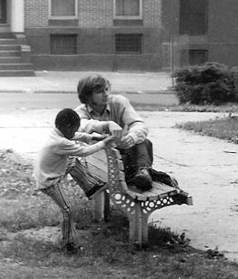
Baltimore, 1970

Slide 4
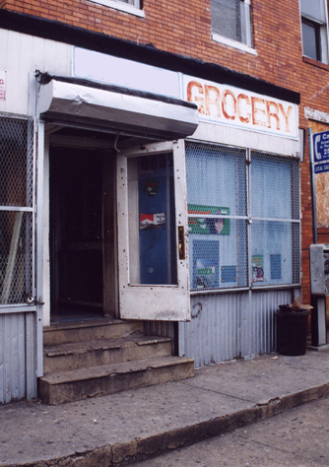
High-Risk Neighborhoods
No sources of healthy food
Unemployment
No decent housing
Unsafe play areas
Crime

Slide 5
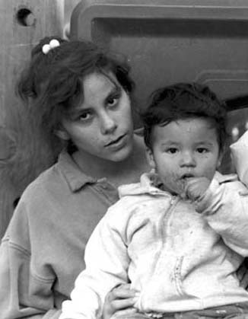
Nurse Family Partnership
Prenatal and infancy home visiting by nurses
Focused on low-income mothers with no previous live births
Clarity in goals, objectives, and methods
Activates and supports parents’ instincts to protect their children
Strengths-based

Slide 6
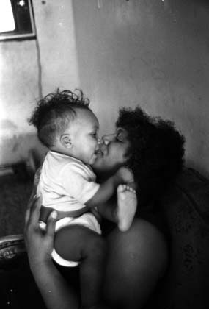
NURSE FAMILY PARTNERSHIP’S
THREE GOALS
Improve pregnancy outcomes
Improve child health and development
Improve parents’ health and economic self-sufficiency

Slide 7
Prenatal
Health-Related
Behaviors
Child Neurodevelopmental
Impairment
Child/Adolescent
Functioning
Dysfunctional
Caregiving
Antisocial
Behavior
Substance
Abuse
Program
Emotional/Behavior
Dysregulation
Cognitive
Impairment
Maternal
Life Course
Closely Spaced
Unplanned Pregnancy
Negative
Peers
Welfare Dependence
Substance Abuse

Slide 8



TRIALS OF PROGRAM
Elmira, NY
1977
Memphis, TN
1987
Denver, CO
1994
N = 400
N = 1,138 and N=743
N = 735
Low-income whites
Semi-rural
Low-income
blacks
Urban
Large portion of Latino families
Nurse versus paraprofessional visitors

Slide 9
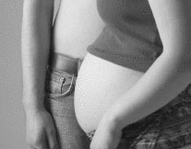

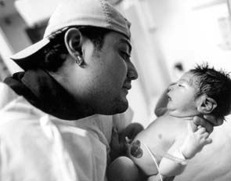
Consistent Results Across Trials
Prenatal health
Children’s injuries
Children’s language and school readiness (low resource mothers)
Children’s behavioral problems
Children’s depression/anxiety
Children’s substance use
Maternal Impairment due to substance use
Short inter-birth intervals
Maternal employment
Welfare & food stamp use

Slide 10
Percentage of Smokers with Preterm Delivery (<37 weeks) - Elmira
p<.05 Pediatrics. 1986; 77; 16-28

Slide 11
Elmira Trial:
Abuse/Neglect through Child Age 2
Note: P-values for nurse P&I vs control comparison

Slide 12
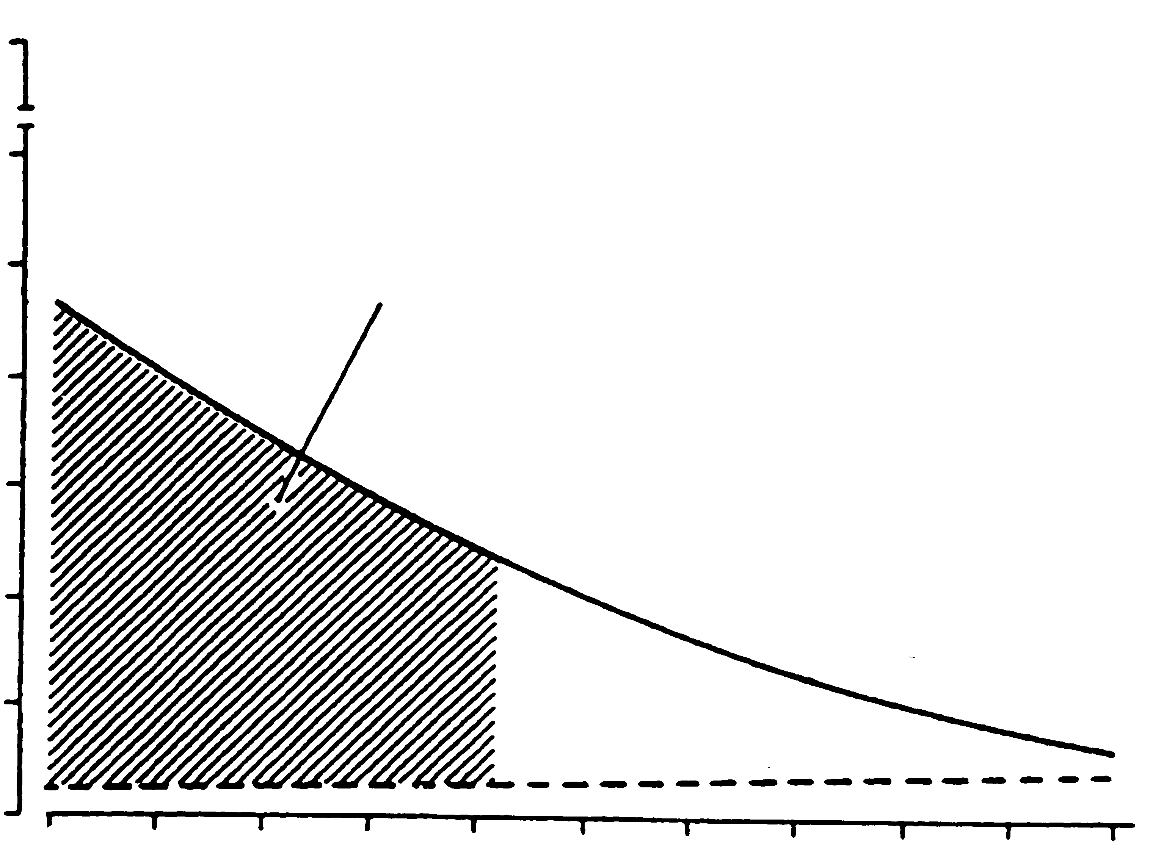
100
60
Simultaneous Region of Treatment
Differences (p < .10)
50
40
% Abuse / Neglect
30
20
Comparison
10
Nurse
0
9
10
11
12
13
14
Maternal Sense of Control

Slide 13
Indicated Cases of Child Abuse and Neglect
0 to 15 Years - Elmira
*P= .03 JAMA, 1997;278:637-643

Slide 14
Maltreatment Reports by Treatment Status and IPV - Elmira
Simultaneous Region of Treatment Differences
(p < .05)

Slide 15
Self-Reported Arrests among Poor Unmarried Mothers
0 to 15 Years - Elmira
*P= .01 JAMA 1997; 278 (8) 637-643

Slide 16
Self-Reported Lifetime Arrests
Elmira Youth Age 19
N = 140
N = 79
N = 91
IRR = 0.43 CI = (0.23 – 0.80) Arch Pediatr Adolesc Med. 2010; 164 (1): 9-15

Slide 17
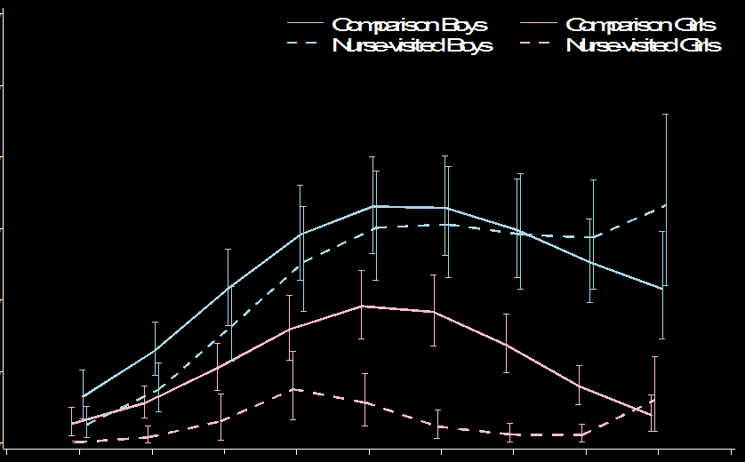


Number of Arrests by Age and
Gender Elmira – Age 19
0.30
Comparison Boys
Nurse Visited Boys
Comparison Girls
Nurse Visited Girls
0.25
Simultaneous Region of Treatment
Differences (p < .10)
0.20
Incidence
0.15
0.10
Comparison
0.05
Nurse
0.00
10
11
12
13
14
15
16
17
18
19
20
Age

Slide 18
Memphis Design
Urban Setting
Sample (N = 1138 for prenatal and N = 742 for postnatal)
  92% African American
  98% Unmarried
  85% < Federal Poverty Index
  64% < 19 years at intake
  2.4 SD above national mean for neighborhood adversity
  Retained >80% of mothers and youth for 18-year follow-up

Slide 19
Treatment Conditions - Memphis
Services | Treatment 1 N=166 | Treatment 2 N=514 | Treatment 3 N=230 | Treatment 4 N=228
Transportation for prenatal care | X | X | X | X
Screening and referral for children |  | X |  | X
Prenatal/postpartum home visiting |  |  | X | X
Infant and toddler home visiting |  |  |  | X

Slide 20
Pregnancy-Induced Hypertension - Mothers
N = 649
N = 442
JAMA 1997; 278: 644-652

Slide 21
Number of Days Hospitalized for Injuries/Ingestions (0-24 months)
Memphis
N = 481
N = 216
P<.01 JAMA 1997; 278: 644-652.

Slide 22
Diagnosis for Hospitalization in which Injuries and Ingestions Were Detected
Nurse-Visited (n=204)
Age Length
(in months) of Stay
Burns (1⁰ & 2⁰ to face) 12.0 2
Coin Ingestion 12.1 1
Ingestion of Iron Medication 20.4 4
JAMA 1997; 278: 644-652.

Slide 23
Diagnosis for Hospitalization in which Injuries and Ingestions Were Detected - Comparison (n=453)
Age Length
(in months) of Stay
Head Trauma 2.4 1
Fractured Fibula/Congenital Syphilis 2.4 12
Strangulated Hemia with Delay in Seeking
Care/ Burns (1⁰ to lips) 3.5 15
Bilateral Subdural Hematoma 4.9 19
Fractured Skull 5.2 5
Bilateral Subdural Hematoma (Unresolved)/
Aseptic Meningitis - 2nd hospitalization 5.3 4
Fractured Skull 7.8 3
Coin Ingestion 10.9 2
Child Abuse Neglect Suspected 14.6 2
Fractured Tibia 14.8 2
Burns (2⁰ face/neck) 15.1 5
Burns (2⁰ & 3⁰ bilateral leg) 19.6 4
Gastroenteritis/Head Trauma 20.0 3
Burns (splinting/grafting) - 2nd hospitalization 20.1 6
Finger Injury/Osteomyelitis 23.0 6

Slide 24
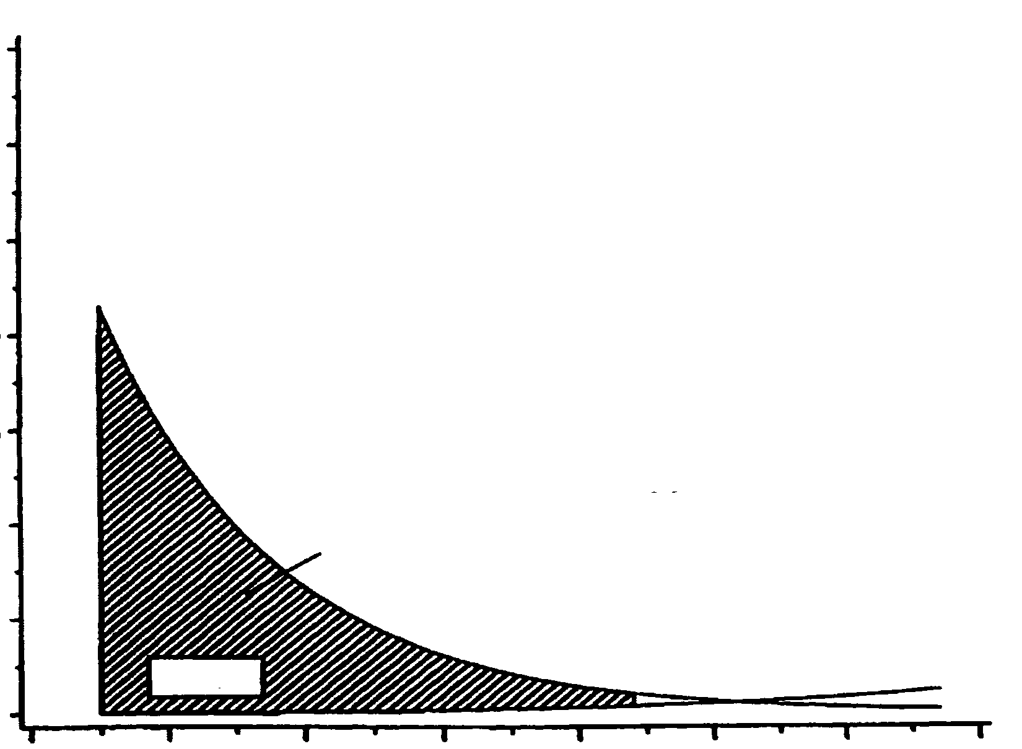
3.5
3.0
2.5
2.0
Comparison
No. Days Hospitalized with Injuries/Ingestions
1.5
Simultaneous Region of Treatment
Differences (p < 0.05)
1.0
0.5
Nurse
0.0
60
70
80
90
100
110
120
130
Mothers’ Psychological Resources

Slide 25
Memphis Analysis of NFP Effects on Physical Aggression: Sex Differences
Outcome: CBCL Parent Report of Physical Aggression:
  Physically attacks others
  Hits others (age 2 only)
  Gets into fights
NV-Control differences:
  Significant reduction in female physical aggression at age 2 for females** but not males
  No intervention effects at ages 6 and 12 for either females or males
  ** p<.01 J Pediar Nur 2010; 25(1) 35-45

Slide 26
Dysregulated Aggression Responses to Story Stems - Memphis Age 6

Slide 27
Percent Incoherent Responses to Story Stems - Memphis Age 6

Slide 28
Memphis Trial:
Math and Reading PIAT (Age 12)

Slide 29
Percent of Children Who Used Tobacco, Alcohol, or Marijuana (Last 30 Days)
Memphis – Child Age 12
P = .04 OR = 0.31
Arch Pediatr Adoles Med, 164(5) 412-418

Slide 30
Percent of Children with Internalizing Disorders – Child Age 12
P = .04 OR = 0.63
Arch Pediatr Adoles Med, 164(5) 412-418

Slide 31
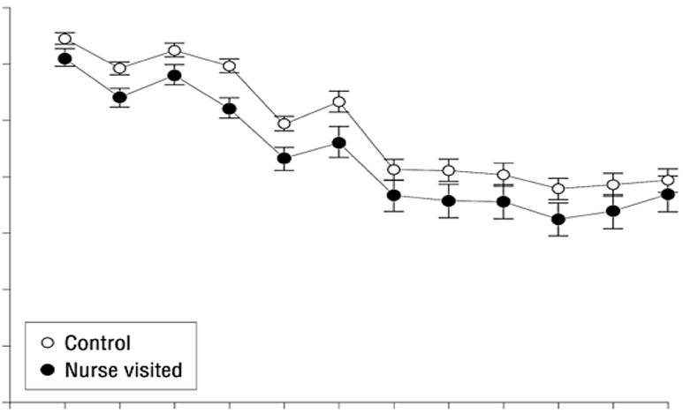
Total Discounted Government Spending (2006 US dollars) after Birth of First Child for Food Stamps, Medicaid, & AFDC/TANF
Control
Nurse Visited
14,000
12,000
Simultaneous Region of Treatment
Differences (p < .10)
10,000
8000
Government Spending, $
6000
4000
Comparison
2000
Nurse
1
2
3
4
5
6
7
8
9
10
11
12
Age

Slide 32
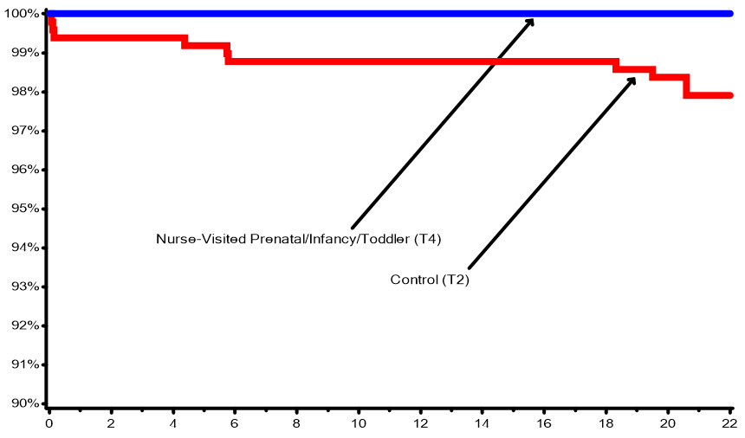
Survival Plots for Intervention and Control Children - Preventable Causes of Death*
Survival – Preventable Causes
Follow-up Time Since Birth (year)
* Sudden Infant Death Syndrome, injury, homicide (T2 vs. T4 p=.02) JAMAPEDIATRICS.2014.472.pages E1-E7.July 7, 2014

Slide 33
18-Year Follow-Up
Cognitive-related outcomes
  Language, math achievement, emotion recognition, working memory, etc.
  Effects hypothesized to be moderated by maternal psychological resources
Behavioral health
  Substance use and disorders, STI’s, HIV risk, internalizing disorders, externalizing disorders, arrests, convictions, including for interpersonal violence
  Effects on arrests and convictions hypothesized to be more pronounced for females

Slide 34
Pattern of Denver Program Effects
Maternal
and
Child
Functioning
Comparison
Para
Nurse

Slide 35
Changes in Urine Cotinine from Baseline to 36 weeks of Pregnancy (ng/mL) - Denver
12.32
88.51
259.0
P-values: p vs c = NS n vs c <.05

Slide 36
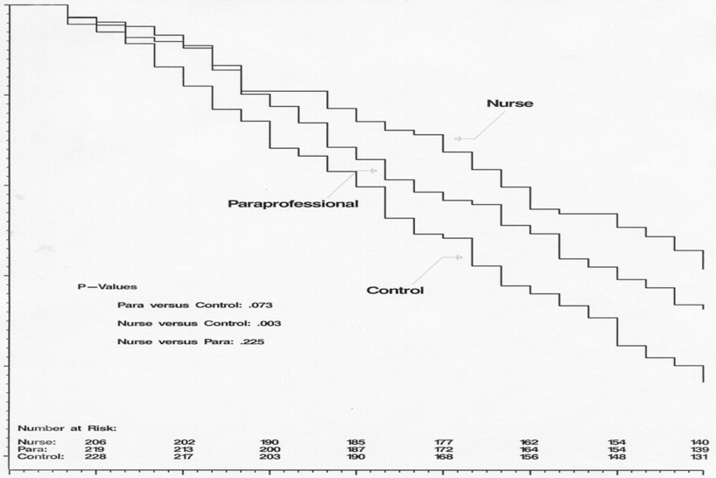
Time to First Subsequent Pregnancy
100
90
Percent Not Pregnant
80
70
60
50
0
3
6
9
12
15
18
21
24
Months Since First Birth

Slide 37
Denver Trial:
Language Delay (21 months)

Slide 38
Denver Trial:
Total Language Score – PLS (Age 4)

Slide 39
Executive Functioning Composite Denver – Child age 4

Slide 40
Cross-Situational Trajectories of Externalizing Problems: Denver
Parent Reports at Ages 2, 4, 6 and 9 + Teacher Reports at Ages 6 and 9
Nurse- and Paraprofessional-Visitation deflected girls
  away from a pattern of persistent high EXT toward moderate EXT and
  away from stable low levels of EXT toward moderate EXT
No effects for males
Prev Sci January 2019

Slide 41

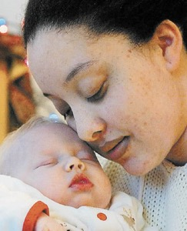
From Science to Practice
Support Organizational and Community Capacity
Education and Consultation
Program Guidelines
Information System
Assessing Program Performance
Continuous Improvement

Slide 42

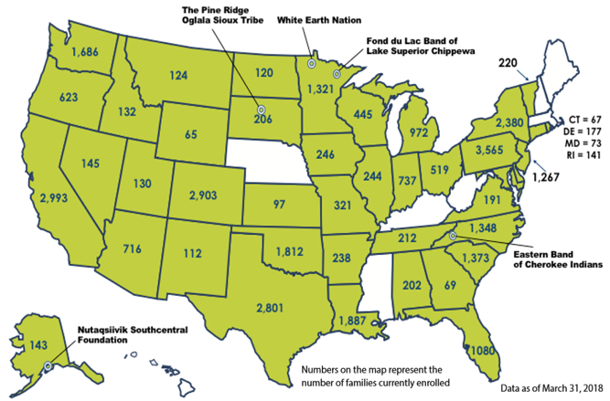
Nurse-Family Partnership is a growing, national program
Where we work
41
States that NFP serves + U.S. Virgin Islands
598
Number of counties NFP is serving
Tribal agencies are denoted by Band
Map does not include program in U.S. Virgin Islands
© Copyright 2014 Nurse-Family Partnership. All rights reserved.
Notes:
Nurse-Family Partnership has had tremendous growth since the National Service Office was founded in 2003 with a mission of replicating the program in communities across the country. As of March 2014, Nurse-Family Partnership programs are in 43 states, the U.S. Virgin Islands and in more than 536 counties.
But we have much work to do – approximately 500,000 children are born to eligible mothers every year. And while we have accomplished a lot, we still have a long way to go to make this program available to all eligible mothers.

Slide 43
International Replication
No presumptions
Adaptation – feasibility & acceptability
Pre-test and small-scale trial
Larger trial (if population sufficiently large and feasible)
Faithful replication of adapted program
International societies:
  UK – England, Scotland, Northern Ireland
  Australia – aboriginal families
  Canada – ON and BC
  Norway
  Bulgaria – Roma families
  American Indians & Alaskan Natives

Slide 44
Test Innovations in Model and Implementation
Participant retention and completed home visits - RCT
Intimate partner violence - RCT
Hormonal contraception - RCT
New method to observe & promote caregiver-child interaction – DANCE/DANCE STEPS
Maternal depression and anxiety - RCT
Development of STAR (Strength and Risk) framework to guide program implementation
Modernize NFP with telehealth, STAR, electronic facilitators, and retention intervention
Improve NFP - child welfare & primary care collaboration
Pilot and test program for multiparous women and those with substance abuse
Pediatrics 2013; 132; S110

Slide 45
Implications for Future Work
Gain insight into the patterns of sex-moderated effects found here
Greater emphasis within NFP on setting effective limits – especially for non-compliant males
Greater attention to linking NFP with programs beginning at age 2 focused on behavioral regulation
  Formative development of intervention
  Small-scale trial
  Well-powered RCT

Slide 46


